Slide 1
Riddles Project In BYOB (Build Your Own Blocks)
Step 1 (OPTION 1):
Design an algorithm using a flowchart icons:
When Green Flag Clicked
Initialize Variables
Tries, Answer
Tries is less than or equal to 3
No
Yes
Tries = Tries + 1
Ask a Riddle
Guess is Equal to Answer
No
Yes
Print “Well Done, you got the answer correct in *Tries* guesses!”
Print “I’m sorry, that is incorrect. The answer to the riddle was *Answer*”
End Program

Slide 2
Riddles Project In BYOB (Build Your Own Blocks)
Step 1 (OPTION 2):
Design a psedocode algorithm:
WHEN the Green Flag is clicked
INITIALIZE Tries ← 0
INITIALIZE Answer ← “A Candle”
Asking Riddle:
IF Tries > 3:
OUTPUT Riddle
SET Tries ← Tries + 1
INPUT Guess to Riddle
IF Guess to Riddle ← Answer:
GOTO Asking Riddle
ELSE:
OUTPUT “Well Done, you got the answer correct in *Tries* guesses!”
ELSE:
OUTPUT “I’m sorry, that is incorrect. The answer to the riddle was *Answer*”
END PROGRAM

Slide 3
Riddles Project In BYOB (Build Your Own Blocks)
Step 2:
Success Criteria:
Ask the user a riddle.
Keep asking the riddle until the user answers correctly or they have had 3 guesses.
Keep a count of how many attempts the user has entered their answer.
If the user has guessed the riddle in 3 guesses or fewer it should congratulate them and tell them how many guesses it took them to guess the answer, and stop running.
If the user does not guess the riddle after 3 guesses it should tell
them the correct answer and, stop running.
Step 3:
Listing Variables:
Tries
Answer (to the riddle)
Answer (that the user has given)

Slide 4
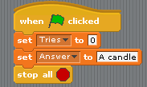
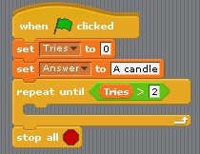
Riddles Project In BYOB (Build Your Own Blocks)
Step 4:
Making the Program:
1.) I started off by initializing the variables I would need. I did not need to initialize the variable “Answer (that the user has given)”, because this variable is automatically generated by BYOB when a question is asked.
2.) I then added a Repeat Until control block that would work with the Tries variable, I initialized.

Slide 5
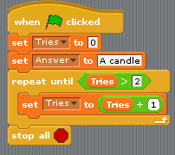
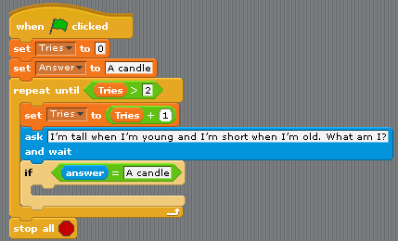
Riddles Project In BYOB (Build Your Own Blocks)
Step 4 (continued) :
Making the Program:
3.) I then added, at the beginning of the repeat until block, a block that would set the variable Tries to itself plus 1. Hence whenever the repeat until block starts to go through its contents, it will keep track of the number of times it has done this, and thus keep track of the number of times the user has tried to answer the riddle.
4.) I then asked the riddle, and used an If block to verify whether the users input (which is automatically assigned to a variable named “answer”), matches my initialized variable called “Answer”, to check whether the user’s guess is correct.

Slide 6
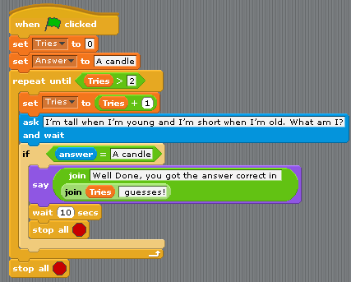
Riddles Project In BYOB (Build Your Own Blocks)
Step 4 (continued) :
Making the Program:
5.) If the user’s input matched the answer to the riddle, I would have the program display a congratulatory message that also displayed the number of tries it took the user to guess the answer. I realised that if the program ended straight after the message was displayed, the message would disappear – so, I added a wait block, that waited 10 seconds (a long enough time for the user to read the message), and then stopped the program.

Slide 7
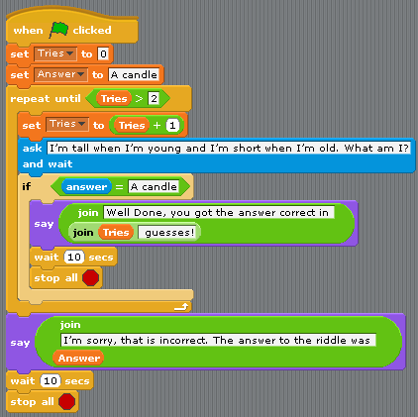
Riddles Project In BYOB (Build Your Own Blocks)
Step 4 (continued) :
Making the Program:
6.) After that, I added a message that would appear if the user had not guessed the answer to the riddle in 3 guesses. The message gave the answer to the riddle. I also added a 10 second wait after the message, before stopping the program.

Slide 8
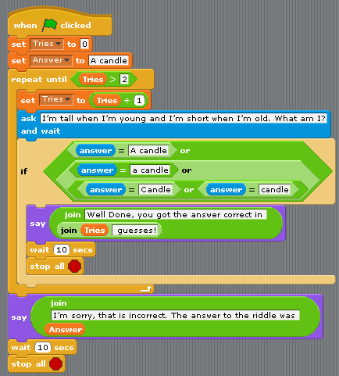
Riddles Project In BYOB (Build Your Own Blocks)
Step 4 (continued) :
Making the Program:
7.) I realised that the program was very specific about the answer, as it must be exactly “A candle” to be classed as correct. So, I modified the If block that compared the user input to the correct answer to the riddle, to have several variations of the answer – thus, added more lenience on “user-inputted” terminology.

Slide 9
Riddles Project In BYOB (Build Your Own Blocks)
Step 5:
Testing the program:
Test No. | Success Criteria | Data Used (when applicable) | Expected Output/ Outcome | Real Output/ Outcome
1 | Ask the user a riddle | Riddle var., Tries var. | The Riddle | The Riddle
2 | Keep asking the riddle until the user answers correctly or they have had 3 guesses. | Riddle var., Tries var., Answer var., Correct Answer var., | The Riddle | The Riddle
2 (also) | Keep track of how many attempts the user has taken. | Tries. var, | To continue asking the riddle if under 3 tries. | To continue asking the riddle if under 3 tries.
3 | If the user has guessed the riddle in 3 guesses or fewer, it should congratulate them and tell them how many guesses it took them to guess the answer, and stop running. | Tries var., Answer var., Correct Answer var., | Congratulations message and display of how many attempts it took them to answer the riddle. | Congratulations message and display of how many attempts it took them to answer the riddle.
3 (also) | If the user does not guess the riddle after 3 guesses it should tell them the correct answer and, stop running. | Tries var., Answer var., Correct Answer var., | Display the correct answer to the riddle | Display the correct answer to the riddle

Slide 10
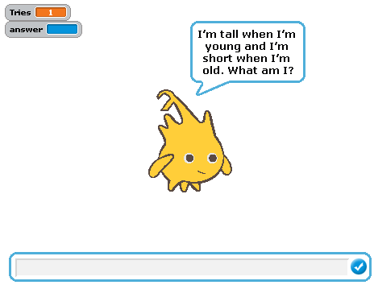
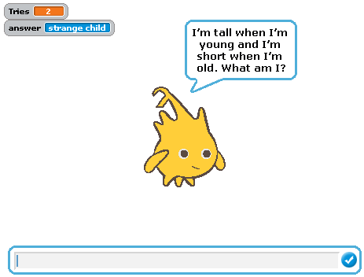
Riddles Project In BYOB (Build Your Own Blocks)
Step 5 (continued):
Testing the program (evidence):
1
Asks Question and allows user input
Keeps track of
Attempts
Continues to ask question when wrong answer is inputted and when the user has not had 3 tries.
2

Slide 11
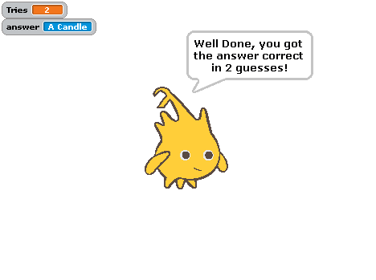
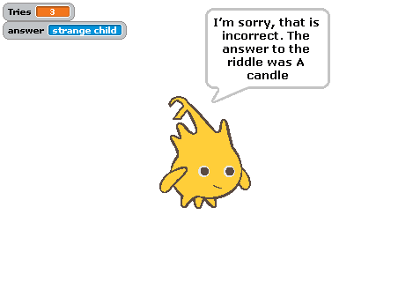
Riddles Project In BYOB (Build Your Own Blocks)
Step 5 (continued):
Testing the program (evidence):
User inputted correct answer in under 3 guesses
Program outputs congratulatory message and the number of tries it took them, to get the correct answer
3
User did not guess the correct answer in under three guesses
Program outputs message telling user the correct answer

Slide 12
Riddles Project In BYOB (Build Your Own Blocks)
Step 6:
Evaluation:
Success Criteria, with cross-referencing
Ask the user a riddle: the program asks the user a riddle and gives them the chance to input an answer, as seen in Stage 1 of testing.
Keep asking the riddle until the user answers correctly or they have had 3 guesses: the program will continue to ask the user a riddle, as long as the automatically-generated “answer” does not match the answer to the riddle and the user has not tried to guess the answer to the riddle more than 3 times. The program also keeps track of the amount of times the user has tried to answer the riddle successfully. Evidence of this can be seen in Stage 2 of testing.
If the user has guessed the riddle in 3 guesses or fewer, it should congratulate them and tell them how many guesses it took them to guess the answer, and stop running OR if the user does not guess the riddle after 3 guesses it should tell them the correct answer and, stop running: the program does: the program congratulates the user if they inputted the correct answer in 3 guesses or fewer as seen in the first picture in Stage 3 of testing. Alternatively, the program will output a message with the correct answer if the user did not input the correct answer in 3 guesses or fewer, as seen in the second picture in Stage 3 of testing.
Strengths/Weaknesses
The program classes many forms of the answer as correct. I.e. It is not case-sensitive and does not require an indefinite article in the answer.
End user testing

